Slide 1
How New Mexico State University Could actually Make Plastic from Cellulose Plant Fibers, even Hemp? Start a New Mexico Plastics Industry from Cellulose Agriculture
David M. Boje
Oct 3 2018

Slide 2
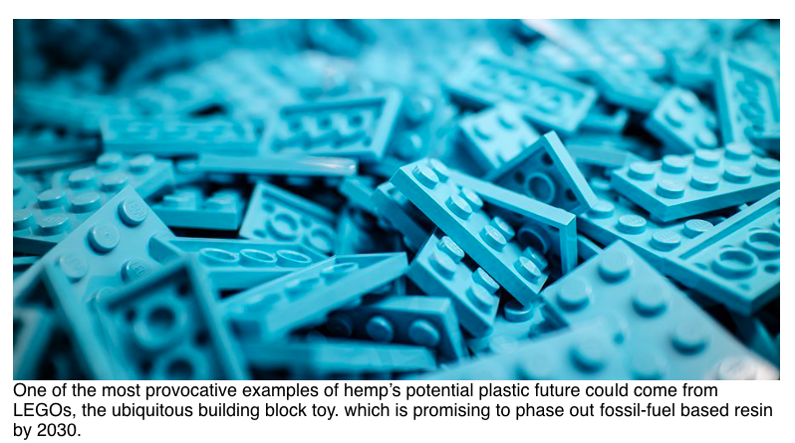
https://ministryofhemp.com/blog/why-isnt-hemp-plastic-everywhere

Slide 3
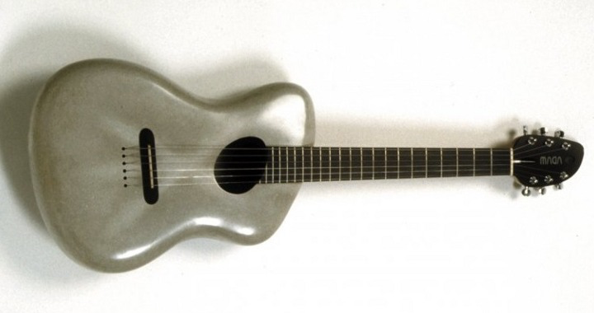
Zeoform is a revolutionary material that changes everything http://www.zeoform.com
Made from cellulose fibers and water – and absolutely nothing else, our patented process converts cellulose fibres into an industrial strength molding material capable of being formed into an unlimited array of products.
https://www.youtube.com/watch?v=kZXmbkO6iuo how Zeoform can make cellulose plastic that is super lightweight

Slide 4
Why NOT? Hemp cellulose making Plastic Products in New Mexico
Cellulose is the most abundant organic polymer found on Earth https://sensiseeds.com/en/blog/hemp-plastics-made/
It is fundamental part of the cell walls of plants and many species of algae.
Although cellulose is primarily used to make paper, it is also used to make a range of different plastics including celluloid, cellophane and rayon
Cellulose is a long-chain polysaccharide with the chemical formula (C6H10O5)_{n} that consists of hundreds or thousands of linked glucose units

Slide 5
Hemp Cellulose
Hemp cellulose can be extracted and used to make cellophane, rayon, celluloid and a range of related plastics,” reported Seshata, a writer at Sensi Seeds in 2014. “Hemp is known to contain around 65-70% cellulose, and is considered a good source (wood contains around 40%, flax 65-75%, and cotton up to 90%) that has particular promise due to its relative sustainability and low environmental impact.”

Slide 6
How to Make Plastic Hemp?
Step 1 powderize https://www.youtube.com/watch?v=O9qoJs3wP3M
Step 2 – mix with water
Step 3 – Fibulae the mix to make super strong microfiber that is very light and durable
Step 4 – Spray, mold, or press into shape of your choice
Step 5 – Biodegradable

Slide 7
Recipe 1: How to Make your own BioPlastic with Corn Starch?
1 tb corn starch
4 tb water (heat water in pot)
1 tsp glycerin (acts as pliable additive; add less for solid mass result)
1 tsp vinegar
INSTRUCTIONS: Mix and let cool to white milky mixture. Keep mixing. Stir till thickens to gel. When bubbles up its done. Spread on silicon heat pad (or aluminum foil), and let dry. https://www.youtube.com/watch?v=5M_eDLyfzp8 ; another version: https://www.youtube.com/watch?v=R3PJeK859iA has more precise process and explaination

Slide 8
2ND HOME RECIPE FOR BIOPLASTIC
Ingredients: https://www.youtube.com/watch?v=bydzCfMQ944
3 BANANA PEELS, VINEGAR, WATER, HONEY, THYME, AND CINNAMEN
Cut banana peels and blend. Add other ingredients and stir and stir in pan, then put on burner, while site as it boils up, off the heat and stain out water. Use the baste as the plastic
Press on oven paper into shape

Slide 9
3rd Recipe for Bioplastic
Use Jicama make starch, mix with glicerin and vinegar, etc.
https://www.youtube.com/watch?v=T3yWRx-ootE

Slide 10
4th Recipe uses paper to make Plastic
Paper is made from cellulose. Can be use to make film, eye glass frames, tooth brush handles, etc. Add some acids, and let sit for hour with occasional stirring to open up the fibers.
Not for a home use, takes some chemistry background
https://www.youtube.com/watch?v=yMG0yfGFJ00

Slide 11
5^{th &} 6th Recipe, orange peels ➔plastic
https://www.youtube.com/watch?v=gJEOGriA5Oo
Or from potatoes’starch (BBC good one)https://www.youtube.com/watch?v=Lhigu23NQlw
Make jewelry with this one https://www.youtube.com/watch?v=-7KCzldr75o

Slide 12
6th Recipe uses Potato Starch to make Plastic
https://www.youtube.com/watch?v=Lhigu23NQlw
Plastic from Potato Starch Recipe (good flexibility)
1 Tbls Potato Starch
1 Tbls water
2 Tsp White Vinegar (acts as an acid)
2 Tsp Glycerine (acts as plastic sizer)
1 Tsp Food Coloring
1/2 Tsp Sodium BI-Carb

Slide 13
7th Recipe – commercial processes from Agri-waste
Bioplastic Agri-waste to make it
https://www.youtube.com/watch?v=oGtlE4MDcMs
Products to make from it (India) with good slide presentation of the data:https://www.youtube.com/watch?v=oGtlE4MDcMs

Slide 14
Dream Story of a New Future
Hemp as a source of bio-ethanol
Hemp is often overlooked as a source of ethanol, but various studies have assessed its potential and found favorable results. While sucrose-containing crops like sugar cane and starchy crops like corn are higher overall producers of ethanol, they are more energy-intensive, more environmentally damaging, and in higher demand for other purposes such as to provide food. https://sensiseeds.com/en/blog/hemp-plastics-made/

